Slide 1
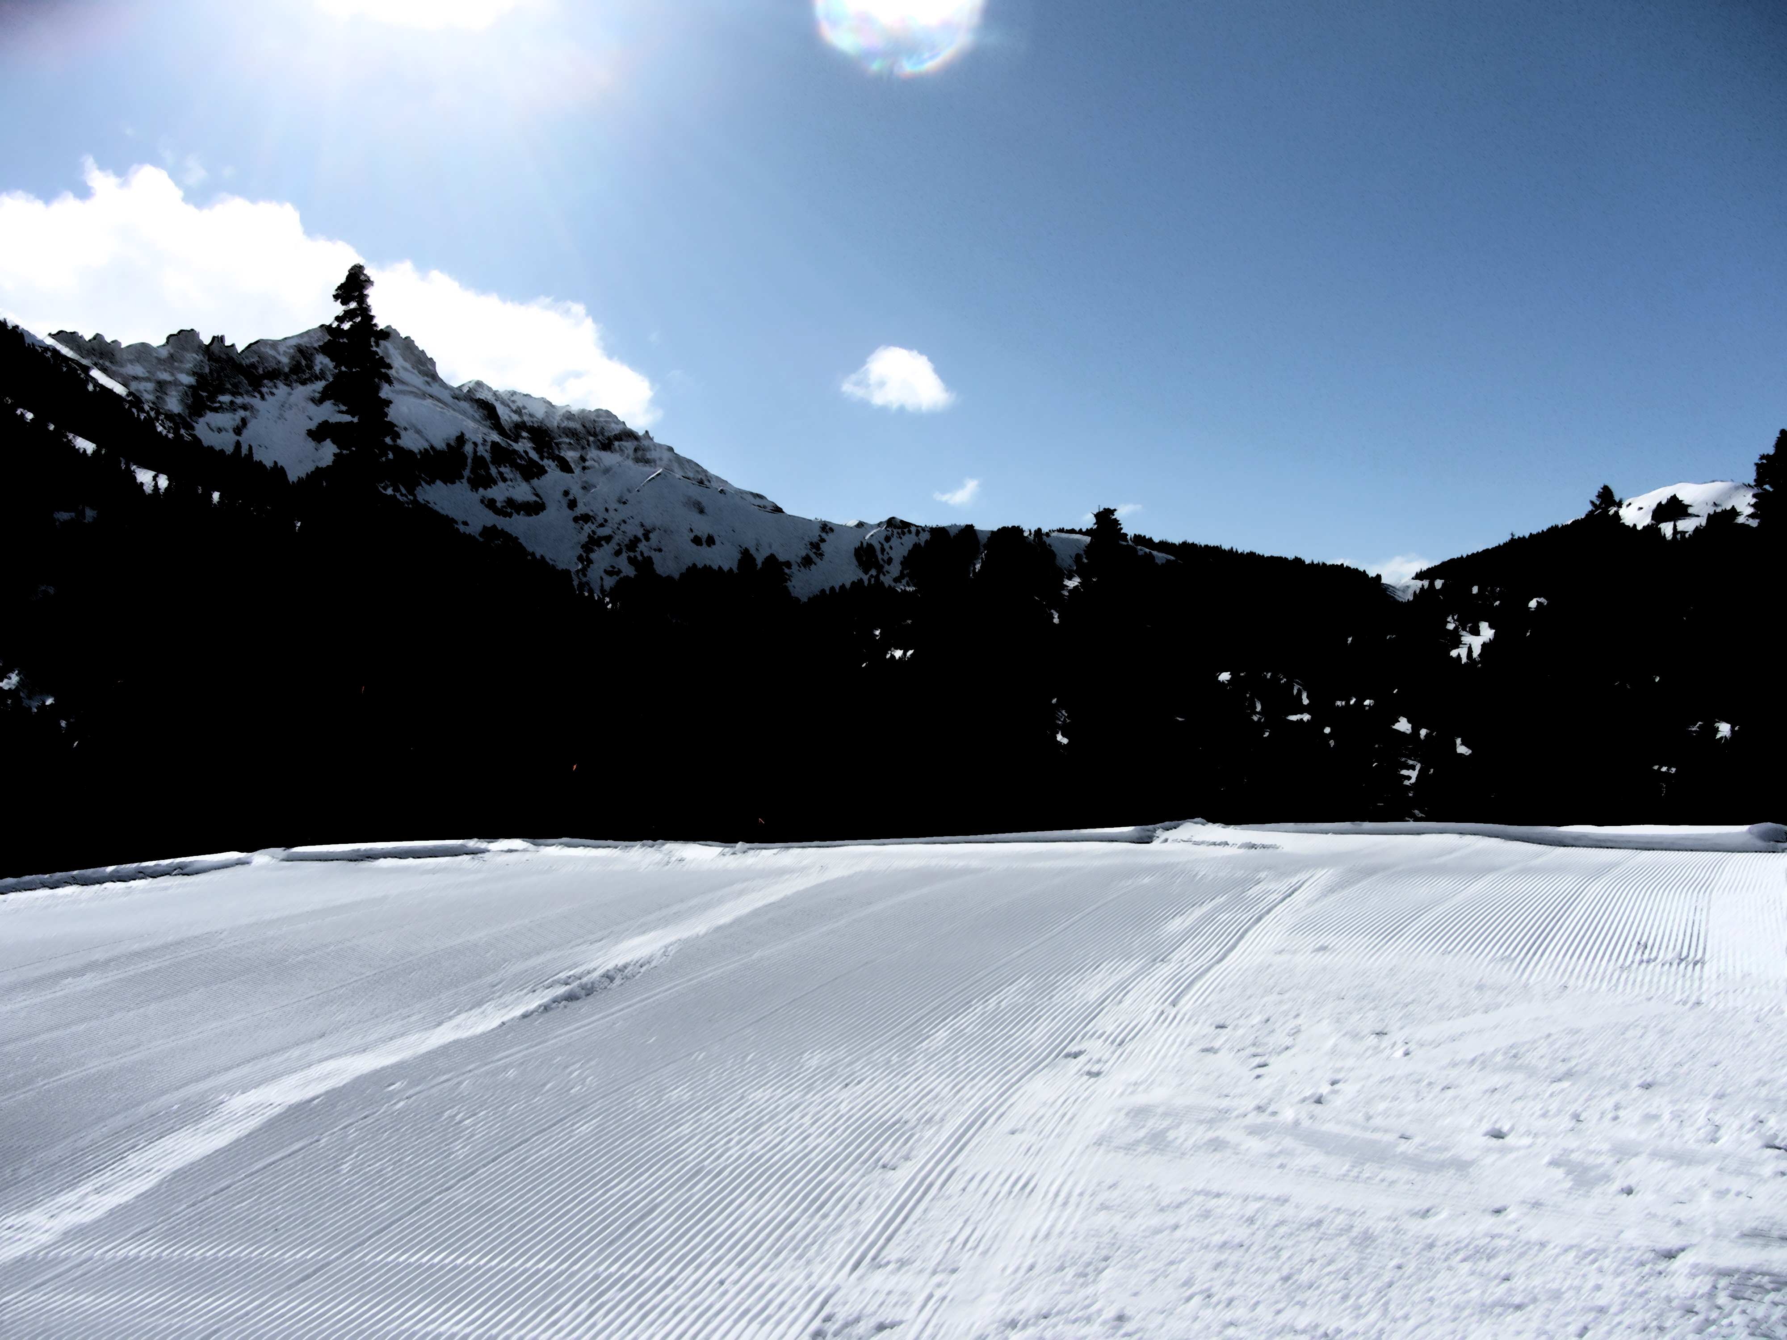
Ski Resort Recommender
Lucy Allen

Slide 2
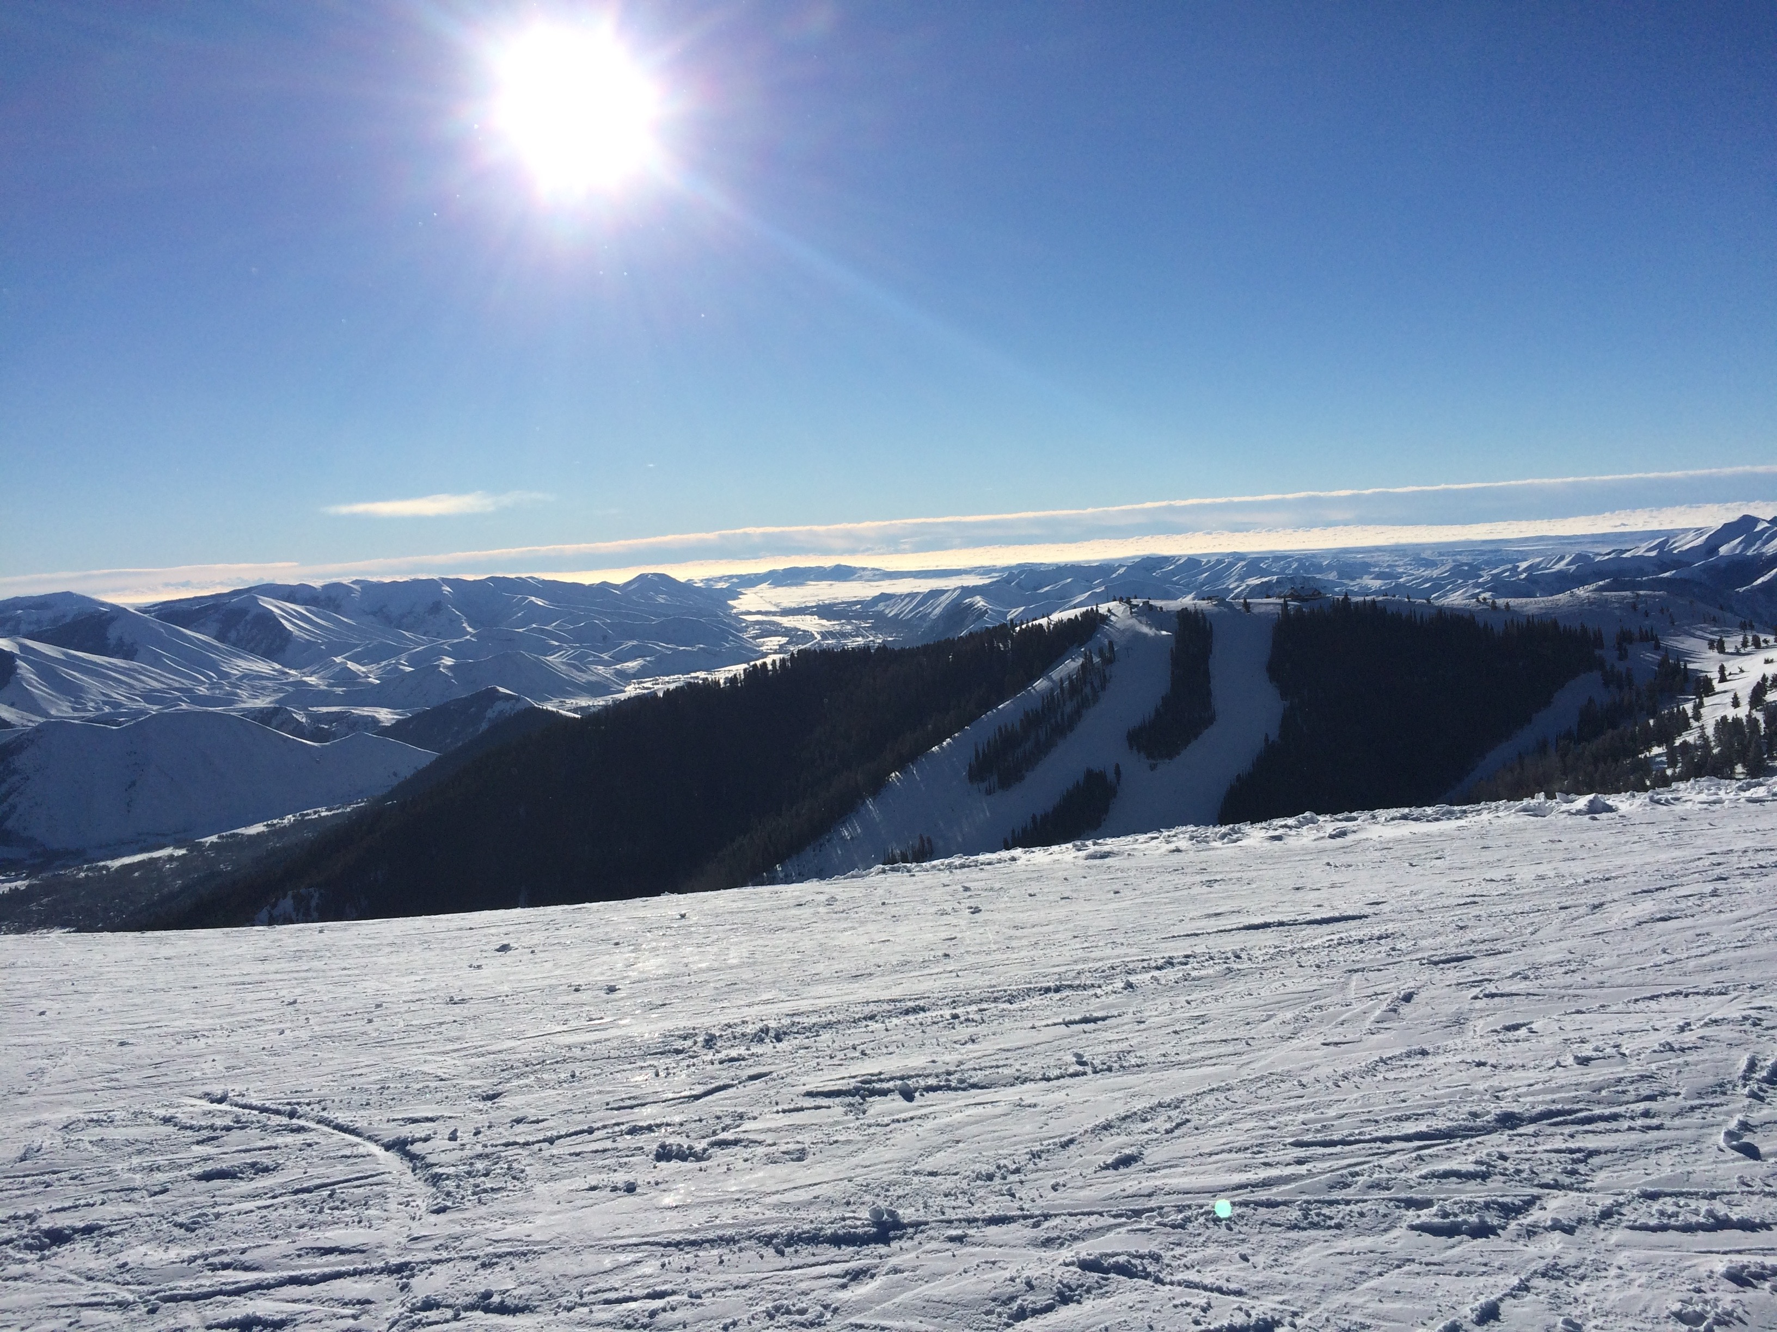
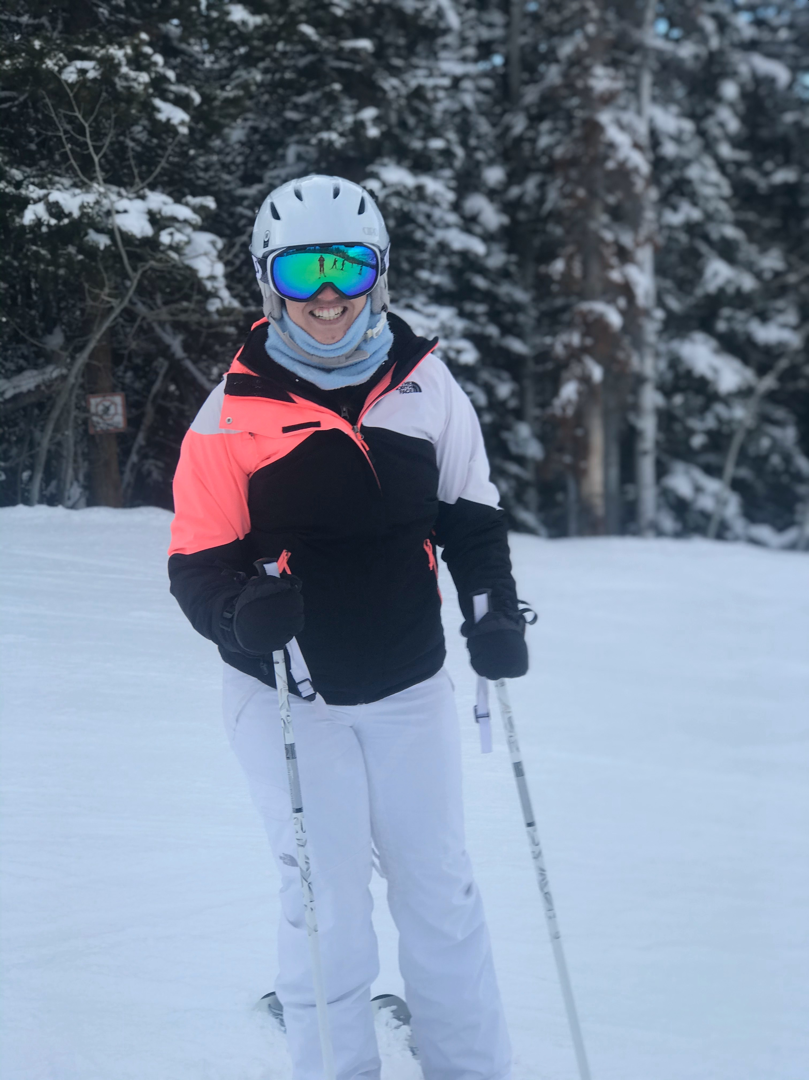
Motivation
How can I use data to determine where I should ski next?
Which resorts are most similar to the ones I’ve been to before?

Slide 3
Methodology
Data Acquisition

Slide 4

Methodology
Data Acquisition
Data Cleaning and Modeling

Slide 5
Methodology
Data Acquisition
Data Cleaning and Modeling
Data Visualization

Slide 6
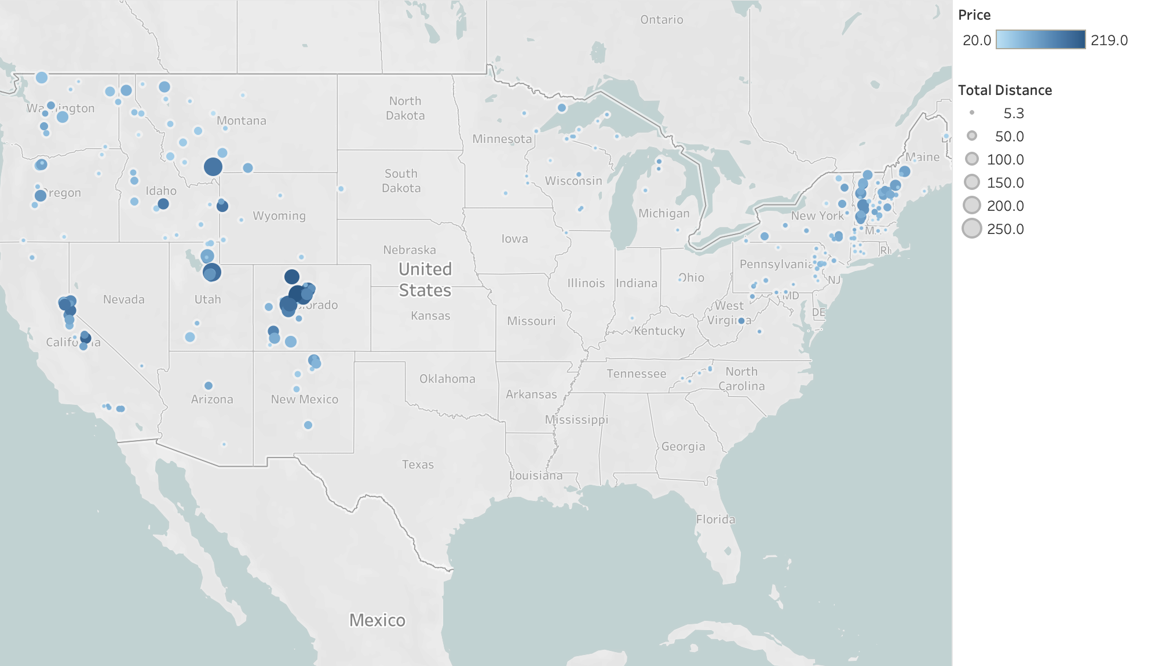
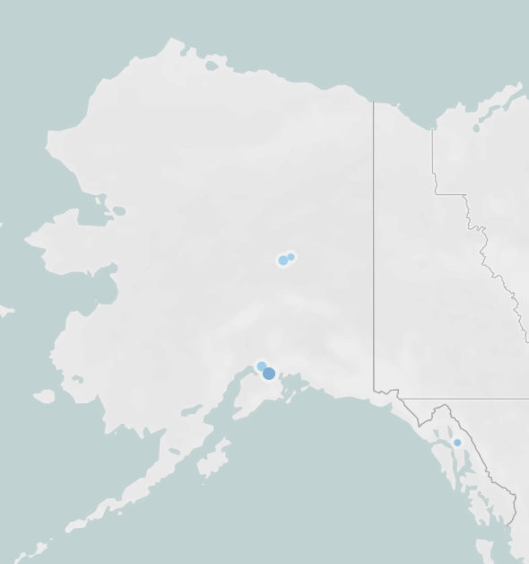

Slide 10
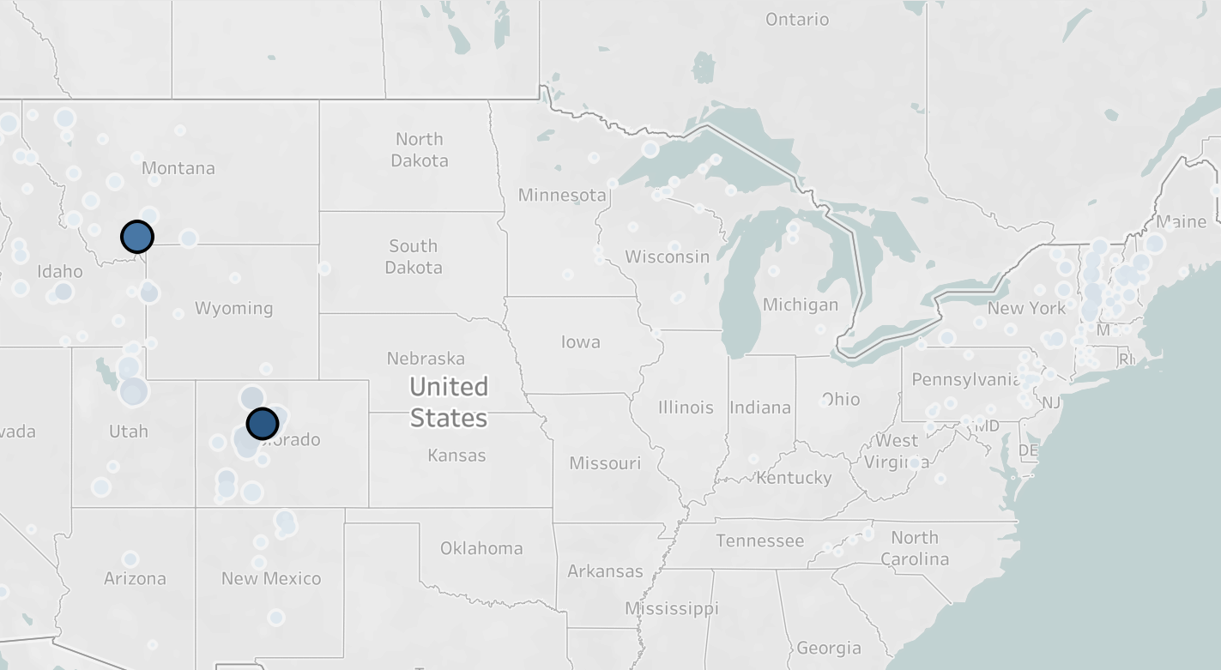
Vail
Skiable Terrain
234 km
Difficulty Level
24% Easy
36% Intermediate
40% Hard
Big Sky:
Skiable Terrain
250 km
Difficulty Level
22% Easy
28% Intermediate
50% Hard
Big Sky
Vail
Distance: 3.34

Slide 11
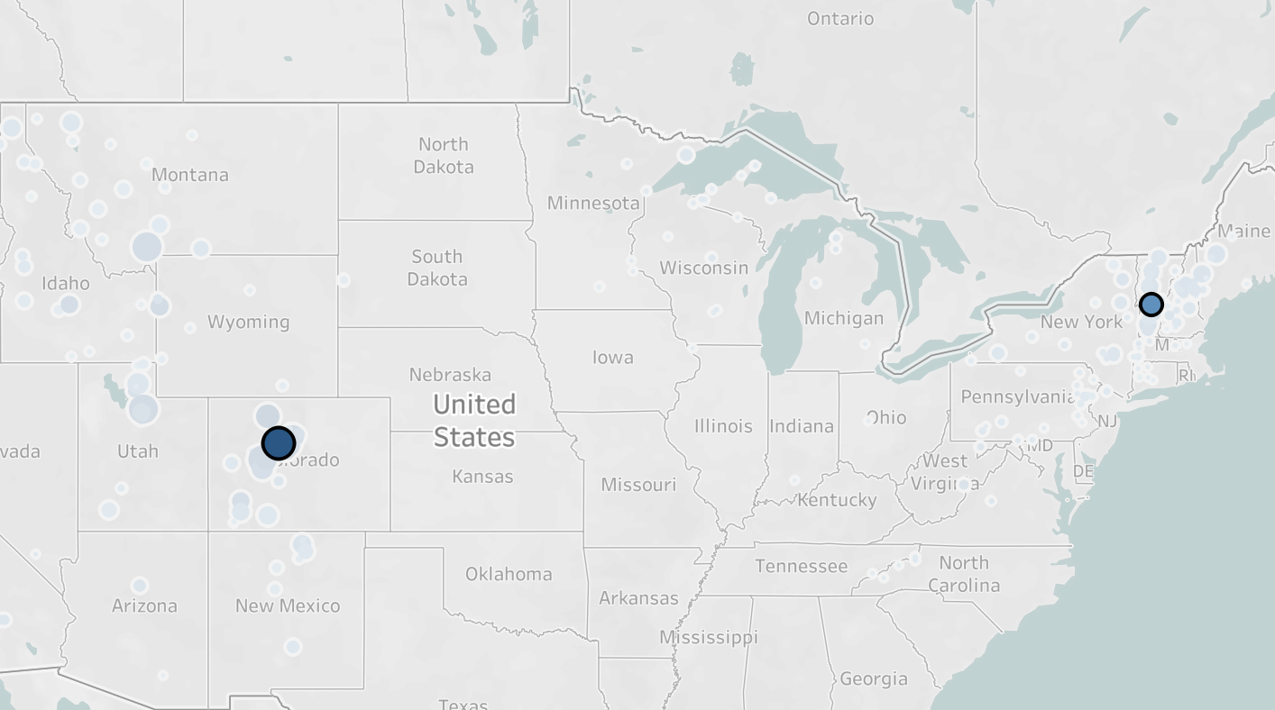
Vail
Skiable Terrain
234 km
Difficulty Level
24% Easy
36% Intermediate
40% Hard
Big Sky:
Skiable Terrain
250 km
Difficulty Level
22% Easy
28% Intermediate
50% Hard
Big Sky
Vail
Distance: 3.34
Vail
Vertical Distance
976 km
Difficulty Level
24% Easy
36% Intermediate
40% Hard
Killington
Vertical Distance
938 km
Difficulty Level
17% Easy
40% Intermediate
43% Hard
Killington
Vail
Distance: 6.35
Notes:
Killington and sugarbush similarity is .9709

Slide 12
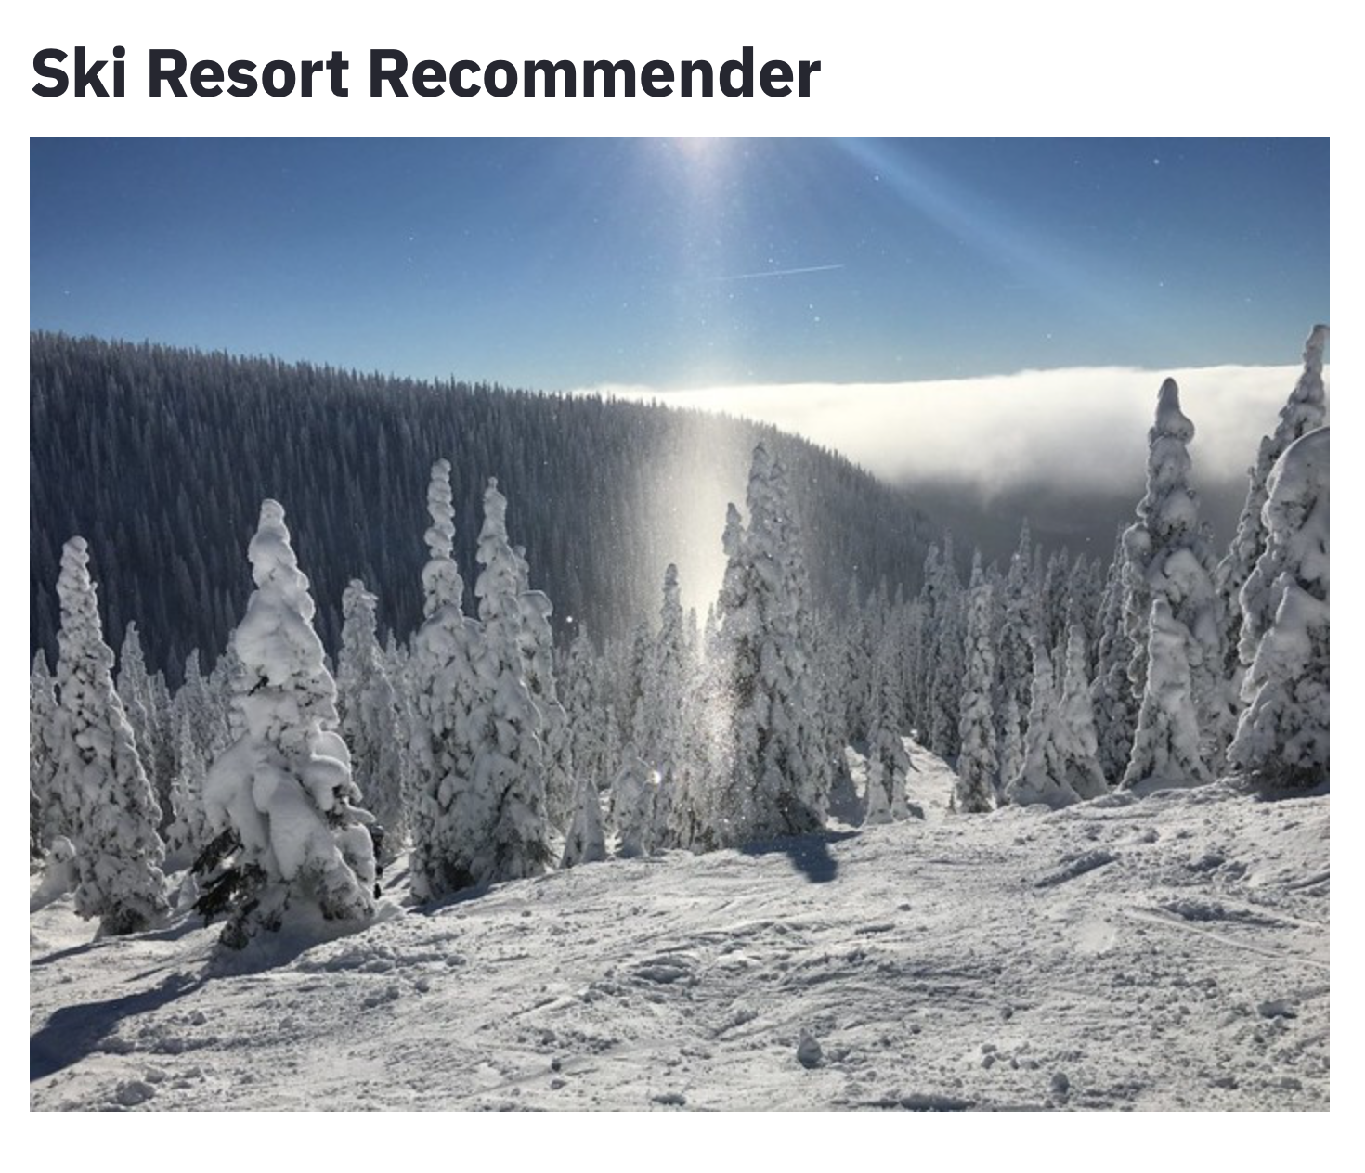

Slide 13
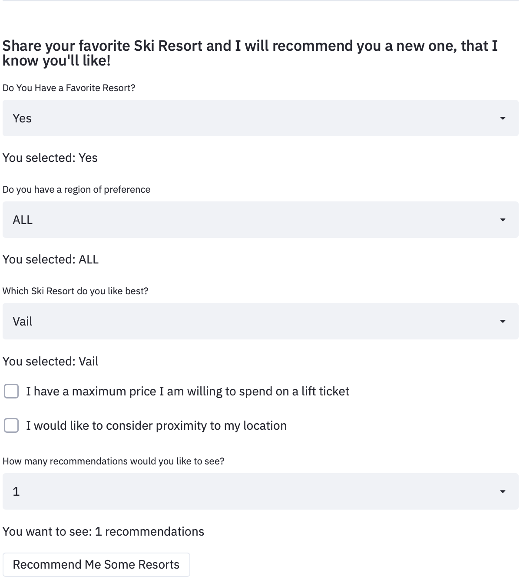

Slide 14
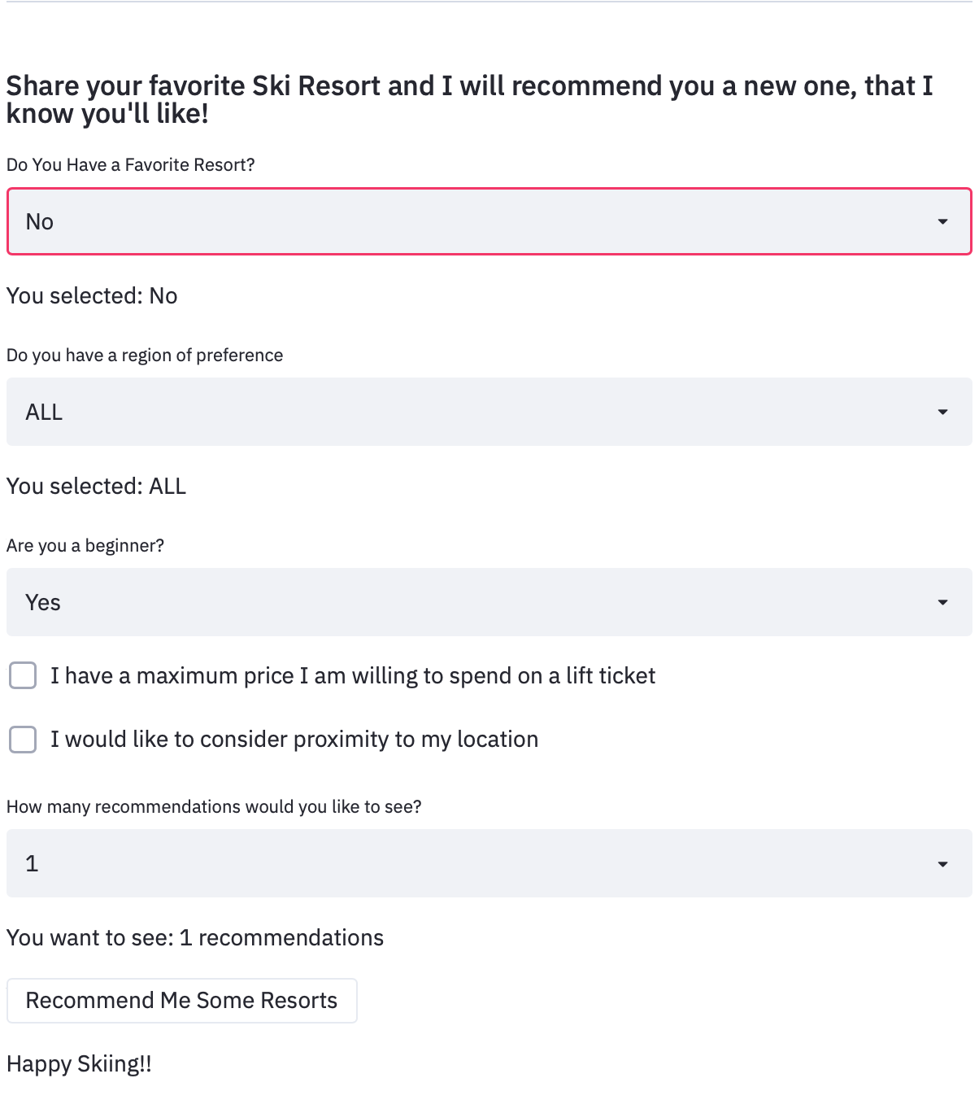

Slide 16
Conclusion
Week Trips
I should plan my next trip out west to:
Park City
Breckenridge

Slide 17
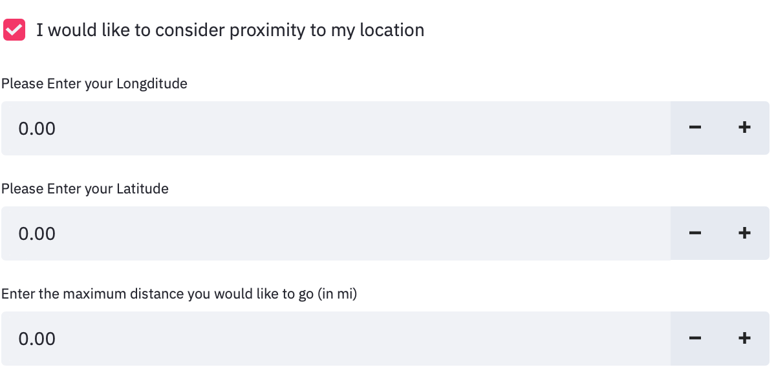
Conclusion
Week Trips
I should plan my next trip out west to:
Park City
Breckenridge
Weekend Trips
Day Trips

Slide 18

Thank You!
Lucy Allen
lallen@colgate.edu
www.linkedin.com/lucy-allen-450a26112
www.github.com/lucy-allen

Slide 19
Appendix
More Tableau Vis

Slide 20


